Slide 1
HUMAN FOLLOWING ROBOT
DIY PROJECT SEC-2 SUBGROUP-3
TEAM TECHSMITHS

Slide 2
PROBLEMS TARGETTED BY OUR PROJECT
AS A METHOD OF REDUCING MANPOWER:
Using robots we can lift heavy machinery parts, Goods etc. in industries , which is practically not possible using manpower.
TO BE USED IN ENVIRONMENTS THAT ARE DIFFICULT TO TRAVERSE FOR HUMANS
When the programming is reversed, this robot will behave as an obstacle avoiding robot and can traverse unknown and dangerous topography which is risky for humans to travel to.
IN SITUATIONS DANGEROUS TO HUMANS DUE TO RISK OF CONTAMINATION,etc.
Our project can help in accessing and delivering medicine to covid carrying patients, and significantly reduce human interaction. It can also help in similar situations with people carrying other communicable diseases and other high risk environments.

Slide 3
OBJECTIVES AND SCOPE OF THE PROJECT
It can be useful in a large no. of industries as equipment careers. This will be more effective and less time consuming than manual labor.
It can be used for customer service in hotesl, restaurants, spas, etc.
Obstacle avoiding robots can be used in almost all mobile navigation systems.
We can save human life by using robots for patrolling purposes instead of humans.

Slide 4
THE FUNCTIONING OF OUR PROJECT
Detects moving object which gets sense from combination of ultrasonic and IR sensors
Micro servo rotates 180 degree with sensors on its head
When some object which moves get close to sensors
DC Motors follow movements of object For demo hands were used to show its working
Uses live signals of Ultrasonic and IR sensor to detect motion
Can move in all directions front, back, right and left

Slide 5
WORKING OF THE PROJECT
This Arduino robot having a sensor that can detect any object near it and can follow this object. if you come in front of the robot it will start following you.
this robot consists ultrasonic sensor and ir sensor which help to follow the object. this is similar to the obstacle avoiding robot only but opposite in the working.
when you come near to the robot starts to follow you. there are 4 wheels in the robot. and 4 motors attached to the chassis.
now there are three sensors on the robot one is an ultrasonic sensor and two ir sensor which arranges like two or sensors left and right to the ultrasonic sensor. and when you put your hand near to the ultrasonic sensor the robot will start forward. and if you turn your hand to the left side the Arduino robot moves on the left side, and if you put your hand in the right the robot will move in the right direction.
when you put your hand in from of the ultrasonic sensor then the sensor detects you and sends this information to the Arduino. there is some distance prefix in the Arduino so if your hand is away from the sensor it will not read that. and if your hand is near to the sensor it will read it. now Arduino knows that there is something in front of the sensor and Arduino send some instruction to the motor driver and motor driver trigger the motors. and the Arduino robot starts to move forward we need to run all motor forward.
what about the sensors. Ir sensor works on infrared light which can also detect the object near to it. so there is two IR sensor one is at the left side of ultrasonic sensor and other is at the right side of the ultrasonic sensor. when anything comes near to the left sensor Arduino got the information that there is something is near to the left sensors and according to the code, the robot will turn to the left. and the same process for the right sensor. so this is how the human following robot works.

Slide 6
HARDWARE COMPONENETS TO BE USED
SL. NO. | COMPONENT | QUANTITY
1 | WIRES, JUMPER WIRE | AS REQUIRED
2 | DC SERVO MOTOR | 1
3 | BO MOTORS and WHEELS | 4
4 | L293D MOTOR | 1
5 | ARDUINO UNO R3 | 1
6 | IR SENSOR | 1
7 | 10650 BATTERY | 1
8 | BATTERY HOLDER | 1
9 | ULTRASONIC SENSOR | 1
10 | SUN-BOARD | 1
TOTAL PRICE : Rs.2450/-

Slide 7
SOFTWARE: ARDUINO IDE
The open-source Arduino Software (IDE) makes it easy to write code and upload it to the board. This software can be used with any Arduino board.
The Arduino Integrated Development Environment - or Arduino Software (IDE) - contains a text editor for writing code, a message area, a text console, a toolbar with buttons for common functions and a series of menus. It connects to the Arduino hardware to upload programs and communicate with them.
ARDUINO IDE IN OUR PROJECT:

Slide 8
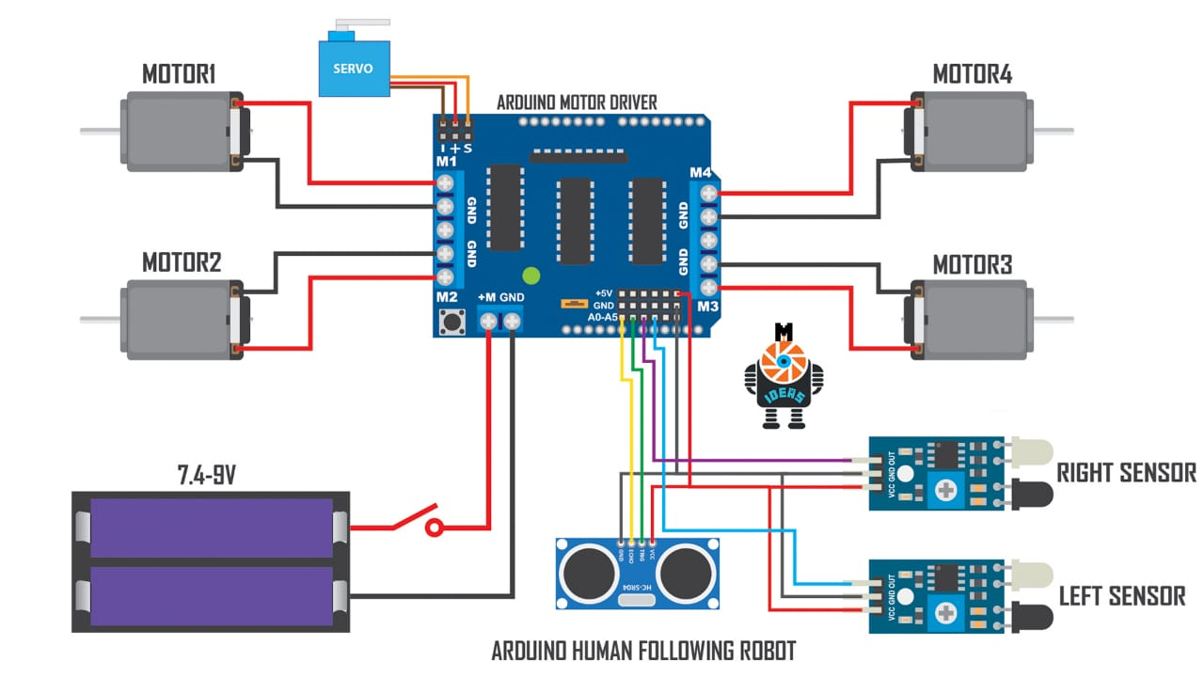
ARDUINO CIRCUIT

Slide 9
ARDUINO CODE
https://drive.google.com/drive/folders/16I47Uxb95vSxACZQggnpE1XT-O-HScGx?usp=sharing

Slide 10
Video Presentation Link
https://www.youtube.com/watch?v=TmbyHF0ZRgI&ab_channel=KeshaveeNandan

Slide 11
WORK OF EACH MEMBER
AMIYA KR. TRIPATHI: ARDUINO CIRCUIT DESIGNING AND CODE WRITING
SURYANSH PATEL: ARDUINO IDE AND CODE WRITING
KESHAVEE NANDAN: HARDWARE AND PRESENTATION
DIVYANSH TRIPATHI: HARDWARE

